Slide 1

LCAP Mid-Year Update
N.E.W. Academy
Of Arts and Sciences
2/24/26
Notes:
Change accent color first and last pages to match school colors. Add school logo.

Slide 2

Agenda
Overview of Requirements
Updated Budget Overview for Parents
LCAP Goals
Progress towards meeting goal
Implementation and Expenditure Status

Slide 3
Local Control Accountability Plan (LCAP)
What is it?
Focus Area
  A comprehensive state plan required of districts and charter schools that details key goals, actions, and budgeted expenditures.
  How additional funds are being used to benefit higher need student groups
  (Low Income, English Learner, and Foster Youth)

Slide 4
Local Control Accountability Plan (LCAP)
LCAP as SPSA
  Charter schools may use the LCAP to also serve as the School Plan for Student Achievement (SPSA) to describe how federal funds will be used to increase student achievement.

Slide 5
LCAP Components 2025-26
Mid-Year Annual LCAP Update
LCAP
Board Presentation
Update on Budget Overview for Parents
Currently available LCAP Outcomes
LCAP Financial Expenditures YTD
LCAP Actions Implementation Update
Budget Overview for Parents
2025-26 Annual Update Actions and Expenditures
Highlights, Identified Needs, Education Partner Engagement
2026-27 Goals, Outcomes, Actions, Expenditures
Increased and Improved Services Requirement

Slide 6
Updated Budget Overview for Parents
Notes:
A concise summary of revenues and expenditures for this year as of first interim reporting.

Slide 7
Budget Overview for Parents
Budget Item | Original Forecast 25-26 | Current Forecast 25-26 Budget as of 10/31/25 | Difference
Total LCFF funds | $6,370,116 | $5,979,589 | -$390,527
LCFF supplemental and concentration grants | $1,787,295 | $1,669,023 | -$118,272
All other state funds | $2,955,476 | $3,194,112 | $238,636
All local funds | $193,000 | $250,560 | $57,560
All federal funds | $833,196 | $826,910 | -$6,286
Total projected revenue | $10,351,788 | $10,251,170 | -$100,618
Total budgeted general fund expenditures | $10,066,250 | $6,153,118 | -$3,913,132

Slide 8
Learning Recovery Emergency Block Grant (LREBG)
Budget Item | Amount
LREBG Previous Allocation Unspent | $781,517
LREBG 2025-26 Allocation | $191,527
Total LREBG Amount Planned to be spent in 2025-26 | $191,527
LEAs must report plans to spend LREBG funds in their LCAP each year. The allocation amount was not provided until late in the budget process last year, so LEAs are allowed to report plans to spend funds from the 2025-26 LREBG allocation in the Mid-Year LCAP.

Slide 9
LCAP Goals:
Progress and Implementation

Slide 10

Goal 1
N.E.W. Academy of Science and Arts creates an exciting, standards-driven learning environment where students use their talents to contribute positively to the community.
Action # | Action Title (* increased service for high need students) | Implementation Status | Budgeted Amount | Expenditures as of 10/31/25
1 | Teacher Recruitment and Retention | Fully Implemented | $- | $-
2 | Curriculum* | Fully Implemented | $240,896 | $165,364
3 | Professional Development* | Fully Implemented | $62,403 | $25,794
4 | Broad Course of Study* | Fully Implemented | $46,604 | $14,601
5 | Instructional Model | Fully Implemented | $1,320,174 | $341,089
6 | Targeted Instructional Support* | Fully Implemented | $573,923 | $176,704
7 | Special Education* | Fully Implemented | $792,667 | $121,854

Slide 11
Goal 1
N.E.W. Academy of Science and Arts creates an exciting, standards-driven learning environment where students use their talents to contribute positively to the community.
Action # | Action Title (* increased service for high need students) | Implementation Status | Budgeted Amount | Expenditures as of 10/31/25
8 | Intervention* | Fully Implemented | $587,619 | $139,601
9 | Technology Access* | Fully Implemented | $176,346 | $70,318
10 | School Data Analysis | Fully Implemented | $- | $-
11 | Assessments* | Fully Implemented | $11,160 | $6,738
12 | ELD Professional Development* | Fully Implemented | $11,515 | $-
13 | ELD Curriculum and Instructional Materials* | Fully Implemented | $118,643 | $94,231

Slide 12

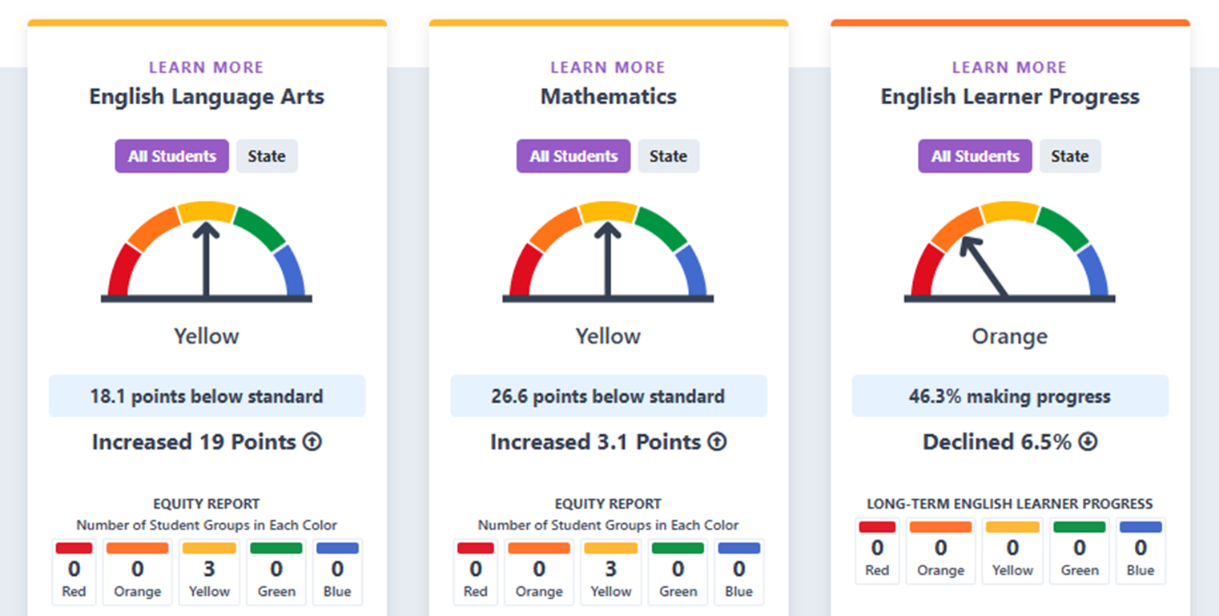
2025 Academic Performance
CA state = Yellow
CA state = Yellow
CA state = Yellow

Slide 13

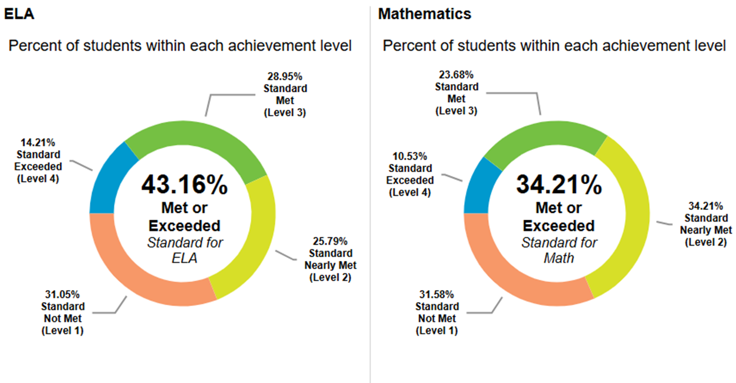
2025
CA state average 48.82% Met or Exceeded ELA Standard
CA state average 37.3% Met or Exceeded Math Standard

Slide 14
Goal 1 Outcomes Continued
Metric | Baseline | Year 2 Outcome | Year 3 Target | Current Difference from Baseline
% of total and EL teachers credentialed and properly assigned | 63.2% | 58.8% | 100% | -4.4%
% of students with access to their own copies of standards-aligned instructional materials for use at school and at home | 100% | 100% | 100% | Maintained
% of students with access to, and are enrolled in, a broad course of study that includes core subjects, VAPA, PE, & Health | 100% | 100% | 100% | Maintained
% adopted state content standards are implemented, including ELD standards | 100% | 100% | 100% | Maintained

Slide 15
Goal 1 Outcomes Continued
Metric | Baseline | Year 2 Outcome | Year 3 Target | Current Difference from Baseline
EL Reclassification Rates | 9% | Not yet available | >10% | Not yet available
California Spanish Assessment (CSA) | Mean Scale Score Grade 3: 347.9 Grade 4: 445.9 Grade 5: 545.1 | Mean Scale Score Grade 3: 252.9 Grade 4: 254.5 Grade 5: 246.6 | 12 point increase | Grade 3: -95 Grade 4: -191.4 Grade 5: -298.5

Slide 16
Goal 2
All students will continue to meet growth targets in attendance to achieve a 98% or more attendance rate and maintain a suspension/expulsion rate of 1% or less.
Action # | Action Title (* increased service for high need students) | Implementation Status | Budgeted Amount | Expenditures as of 10/31/25
1 | Attendance Initiatives* | Fully Implemented | $102,662 | $31,779
2 | SEL/Mental Health* | Fully Implemented | $100,187 | $22,928
3 | Health and Safety | Fully Implemented | $797,210 | $345,383
4 | PBIS and Restorative Practices* | Fully Implemented | $81,748 | $22,240

Slide 17
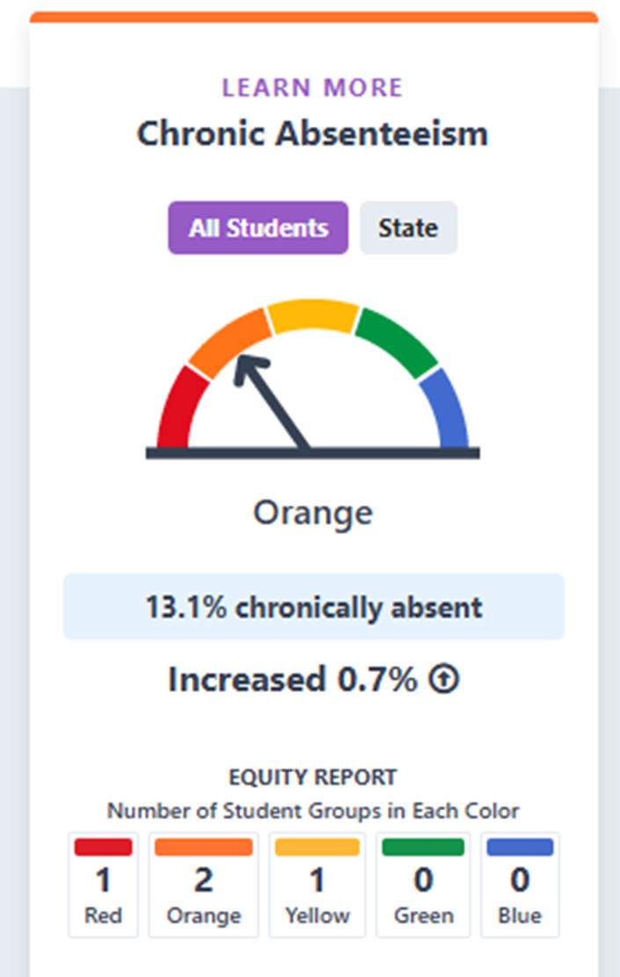
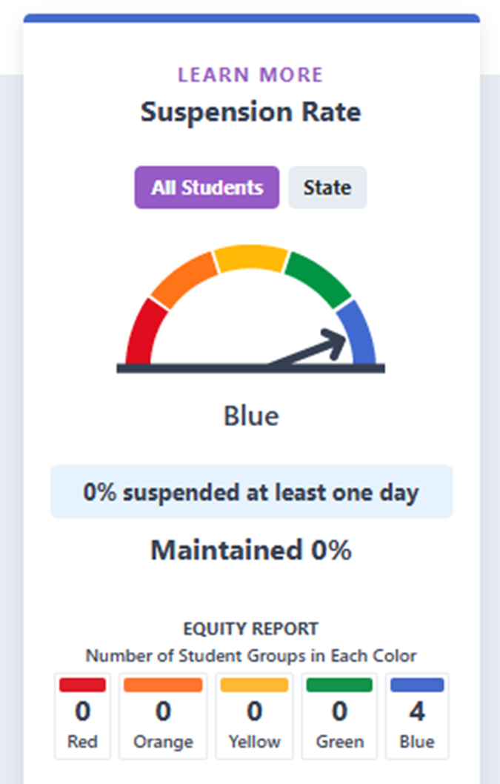
2025 Engagement/Climate Indicators
CA state = Yellow
CA state = Green

Slide 18
Goal 2 Outcomes
Metric | Baseline | Year 2 Outcome | Year 3 Target | Current Difference from Baseline
Attendance rate | 95.28% | 96.03% | 98% | +.75%
Expulsion rate | 0% | 0% | 0% | Maintained
Family Survey: % who respond positively regarding school safety | 93.6% | Not yet available | >90% | Not yet available
Student Survey: % who respond positively regarding school safety | 85% of students always feel safe. 89% always feel safe going and coming from school 95% of students said they always can get help if they have an emergency | Not yet available | 85% of students always feel safe. 85% always feel safe going and coming from school 90% of students said they always can get help if they have an emergency | Not yet available

Slide 19
Goal 2 Outcomes
Metric | Baseline | Year 2 Outcome | Year 3 Target | Current Difference from Baseline
Student Survey: % who respond positively regarding school connectedness | 93% of students agree that adults always care about students. | Not yet available | >90% | Not yet available
Teacher Survey: % who respond positively regarding school safety | 77% | Not yet available | >90% | Not yet available
Teacher Survey: % who respond positively regarding school connectedness | 78% | Not yet available | >90% | Not yet available
Facilities in “good repair” | Met | Met | Met | Maintained

Slide 20
Goal 3
The Charter School will better serve students and families and strengthen parent involvement and participation.
Action # | Action Title (* increased service for high need students) | Implementation Status | Budgeted Amount | Expenditures as of 10/31/25
1 | Parent Involvement* | Fully Implemented | $105,577 | $24,495
2 | Surveys | Fully Implemented | $- | $-
3 | Parent Participation* | Fully Implemented | $3,000 | $3,812

Slide 21
Goal 3 Outcomes
Metric | Baseline | Year 2 Outcome | Year 3 Target | Current Difference from Baseline
Family Survey: % who respond positively regarding school connectedness | 95% of parents feel well-informed of the activities at the school 99% of parents feel they receive clear information about their child’s academic progress | Not yet available | >90% of parents feel well-informed of the activities at the school >90% of parents feel they receive clear information about their child’s academic progress | Not yet available
# of parents participating in school events annually | NA | Not yet available | 50 | Not yet available
Parent -teacher conference attendance rate | 98% | Not yet available | 80% | Not yet available

Slide 22
Thank you for working together to review our progress towards meeting our LCAP goals!
Notes:
Substitute school image or plain with logo.

